Slide 1
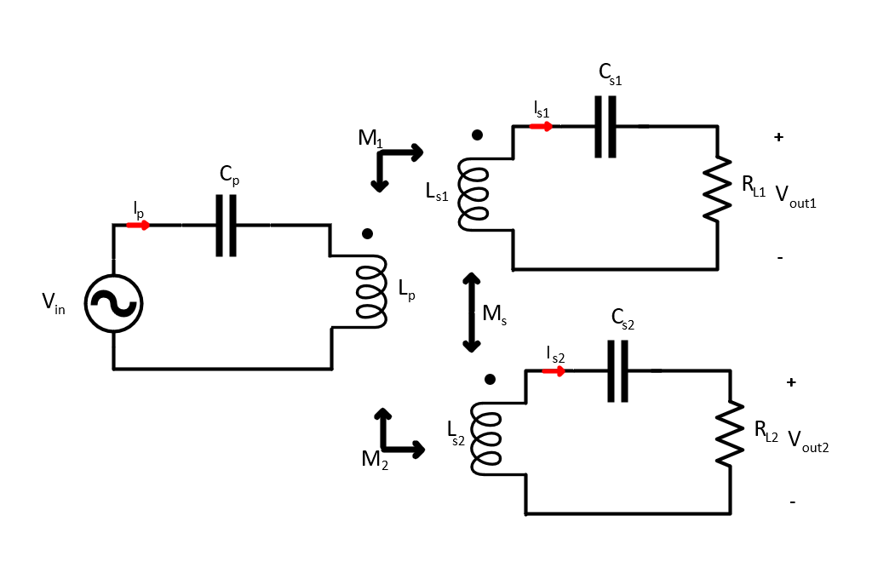
Parameters | Calculations | Values
$V_{out}$ ($V_{rms}$ ) | $$√(P_{o}R_{L})$$ | $$90V$$
$L_{s}$ (H) | $$\frac{{Q^{′}}_{s}R_{L}}{2πf_{op}}$$ | $$68.8μ$$
$I_{s}$ ($A_{rms}$ ) | $$\frac{V_{out}}{R_{L}}$$ | $$5.55A$$
$I_{p}$ ($A_{rms}$ ) | $$\frac{P_{out}}{V_{in}η}$$ | $$5.55A$$
$M$ (H) | $$\frac{I_{s}R_{L}}{2πf_{op}I_{p}}$$ | $$17.19μ$$
$L_{p}$ (H) | $$\frac{M^{2}}{k^{2}L_{s}}$$ | $$107.43μ$$
$C_{p}$ (F) | $$\frac{1}{{\left(2πf_{p}\right)}^{2}Lp }$$ | $X$ ($10.48 n$)
$C_{s}$ (F) | $$\frac{1}{{\left(2πf_{s}\right)}^{2}Ls }$$ | $X$ ($16.36 n$)
Inputs | Values
$V_{in}$ (rms) | $$90V$$
$P_{o}$ (W) | $$500W$$
$${Q′}_{s}$$ | $$4$$
$f_{op}$(Hz) | $$150k$$
$$k$$ | $$0.2$$
$R_{L}$ ($Ω$) | $$16.214$$
Previosuly, operation frequency is chosen as the frequency of
resonant tank of the secondaries and primary.

Slide 2
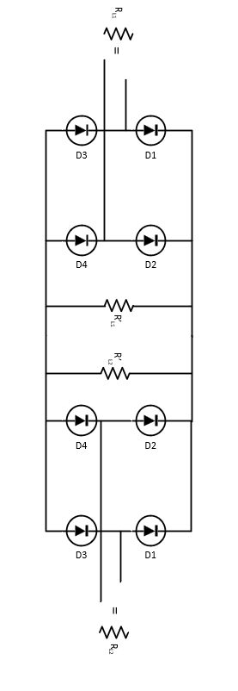
Previosuly, we observed that :
For unequal mutual inductances cause that the module with bigger mutual inductance sees low-resistance load and the module with smaller mutual inductance sees high-resistance load.
Thus, inequality of the mutual led the $R_{L1}^{′} and R_{L2}^{′}$ differences increase.
$${R′}_{L}$$ | $${R′}_{L1}$$ | $${R′}_{L2}$$ | $$R_{L1}$$ | $$R_{L2}$$
20 | ➔20 | ➔ $∞$ | ➔16.214 | ➔ $∞$
Thus , the power is transferred by one seconder module

Slide 3
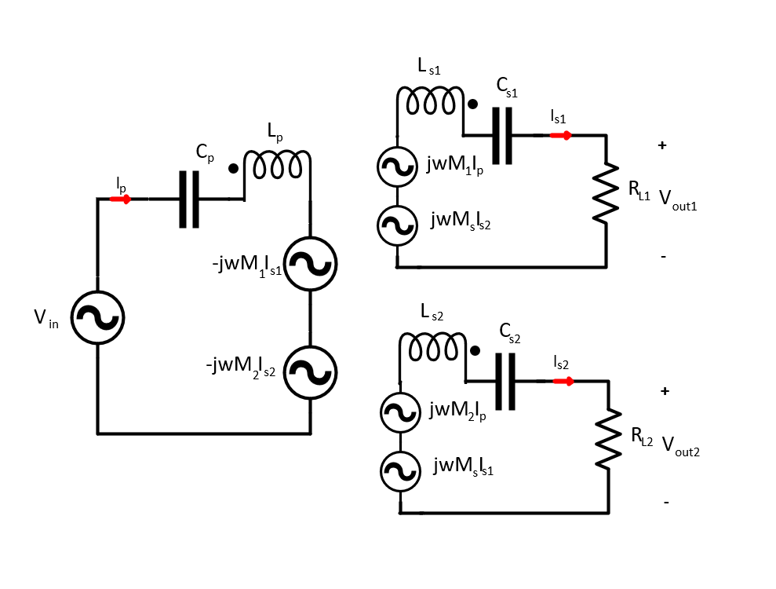
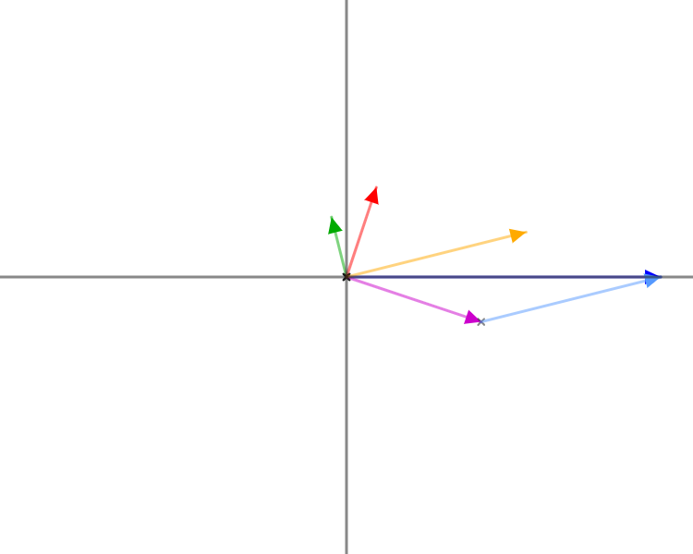
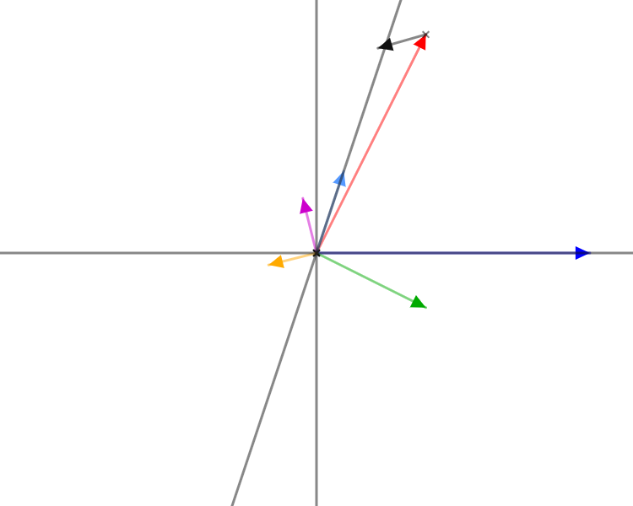
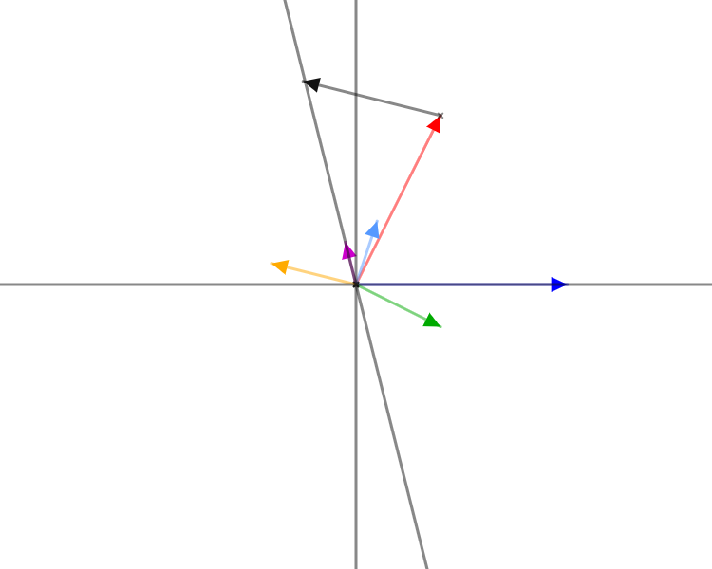
Also, we discovered that cross-coupling can be used to feedback mechanism to keep balance of the load.
Phasor Voltage and Current Representation of the 1Tx-2Rx WPT
$$V_{out}$$
$$wM_{s }I_{s2}$$
$$wM_{1 }I_{p}$$
$$V_{out}$$
$$wM_{2 }I_{p}$$
$$I_{s1}$$
$$wM_{s }I_{s1}$$
$$I_{s2}$$
$$wM_{2 }I_{p}$$
$$I_{s1}$$
$$V_{in}$$
$$I_{s2}$$
$$V_{in}$$
$$I_{s1}$$
$$V_{in}$$
$$I_{s2}$$
$$wM_{s }I_{s1}$$
$$wM_{2 }I_{p}$$
$$wM_{s }I_{s2}$$
$$I_{p}$$
$$wM_{1 }I_{p}$$
$$I_{p}$$
Source Code
Source Code
Source Code

Slide 4
Step 1- Calculation of output voltage and real part of the input current
$$V_{out}=\left(I_{s1}+I_{s2}\right)R_{L}$$
${I_{pf}= I}_{p}.\cos\left(θ\right)=\frac{V_{out}\left(I_{s1}+I_{s2}\right)}{V_{in}}$
Step 2- Calculation of phases of the output currents
$$K_{1}=ωM_{1}I_{s1}$$
$$x=180−acos⁡((V_{in}^{2}−K_{1}^{2}−K_{2}^{2})/(−2K_{1}K_{2}))$$
$$K_{2}=ωM_{2}I_{s2}$$
$$α=atan⁡(\frac{K1+K_{2}\cos\left(x\right)}{K_{2}sin⁡(x)})$$
$$β=α+x$$

Slide 5
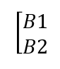
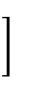
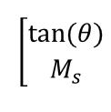
Step 3- Calculation of mutual inductance between secondary coils and phase of input currents (by using second secondary coil)
$$A_{1}=ωM_{2}I_{pf}$$
$$A_{2}=0$$
$$A_{3}=ωI_{s1}cos⁡(90+α)$$
$$A_{4}=ωI_{s1}sind(90+alpha )$$
$B_{1}=V_{out}sin⁡(β)$
$$B_{2}=V_{out}\sin\left(β\right)−ωM_{2}Ip_{f}$$
A =
$$\left[\begin{matrix}A_{1} & A_{3} \\ A_{2} & A_{4}\end{matrix}\right]$$
B =
x=
$$x=A^{−1}B$$
$$M_{s}=x(2)$$
$$θ=atan⁡(x\left(1\right))$$
The formulation can be applied to first seconder coils to find $M_{s}$ and $θ$

Slide 6
Decoupled Receiver |  |  |  | Cross-coupled receivers
Full-Aligned |  | Misaligned |  | Full-Aligned |  | Misaligned
150kHz Resonant Cap | 135kHz Resonant Cap | 150kHz Resonant Cap | 135kHz Resonant Cap | 150kHz Resonant Cap | 135kHz Resonant Cap | 150kHz Resonant Cap | 135kHz Resonant Cap
Tx Current | Tx Current | Tx Current | Tx Current | Tx Current | Tx Current | Tx Current | Tx Current
Rx-1 Current | Rx-1 Current | Rx-1 Current | Rx-1 Current | Rx-1 Current | Rx-1 Current | Rx-1 Current | Rx-1 Current
Rx-2 Current | Rx-2 Current | Rx-2 Current | Rx-2 Current | Rx-2 Current | Rx-2 Current | Rx-2 Current | Rx-2 Current
Tx Voltage (Square) | Tx Voltage (Square) | Tx Voltage (Square) | Tx Voltage (Square) | Tx Voltage (Square) | Tx Voltage (Square) | Tx Voltage (Square) | Tx Voltage (Square)
First mission : We investigate the secondary coupling effect by using the test data which are decoupled 150Khz resonant capacitor and cross-coupled 150kHz resonant capacitor for both aligned and misaligned conditions. (Column 1-5 and column 3-7)

Slide 7
Full-Aligned Coupled

Slide 8
Miss-Aligned Coupled

Slide 9
Full-Aligned Decoupled

Slide 10
Miss-Aligned Decoupled

Slide 11
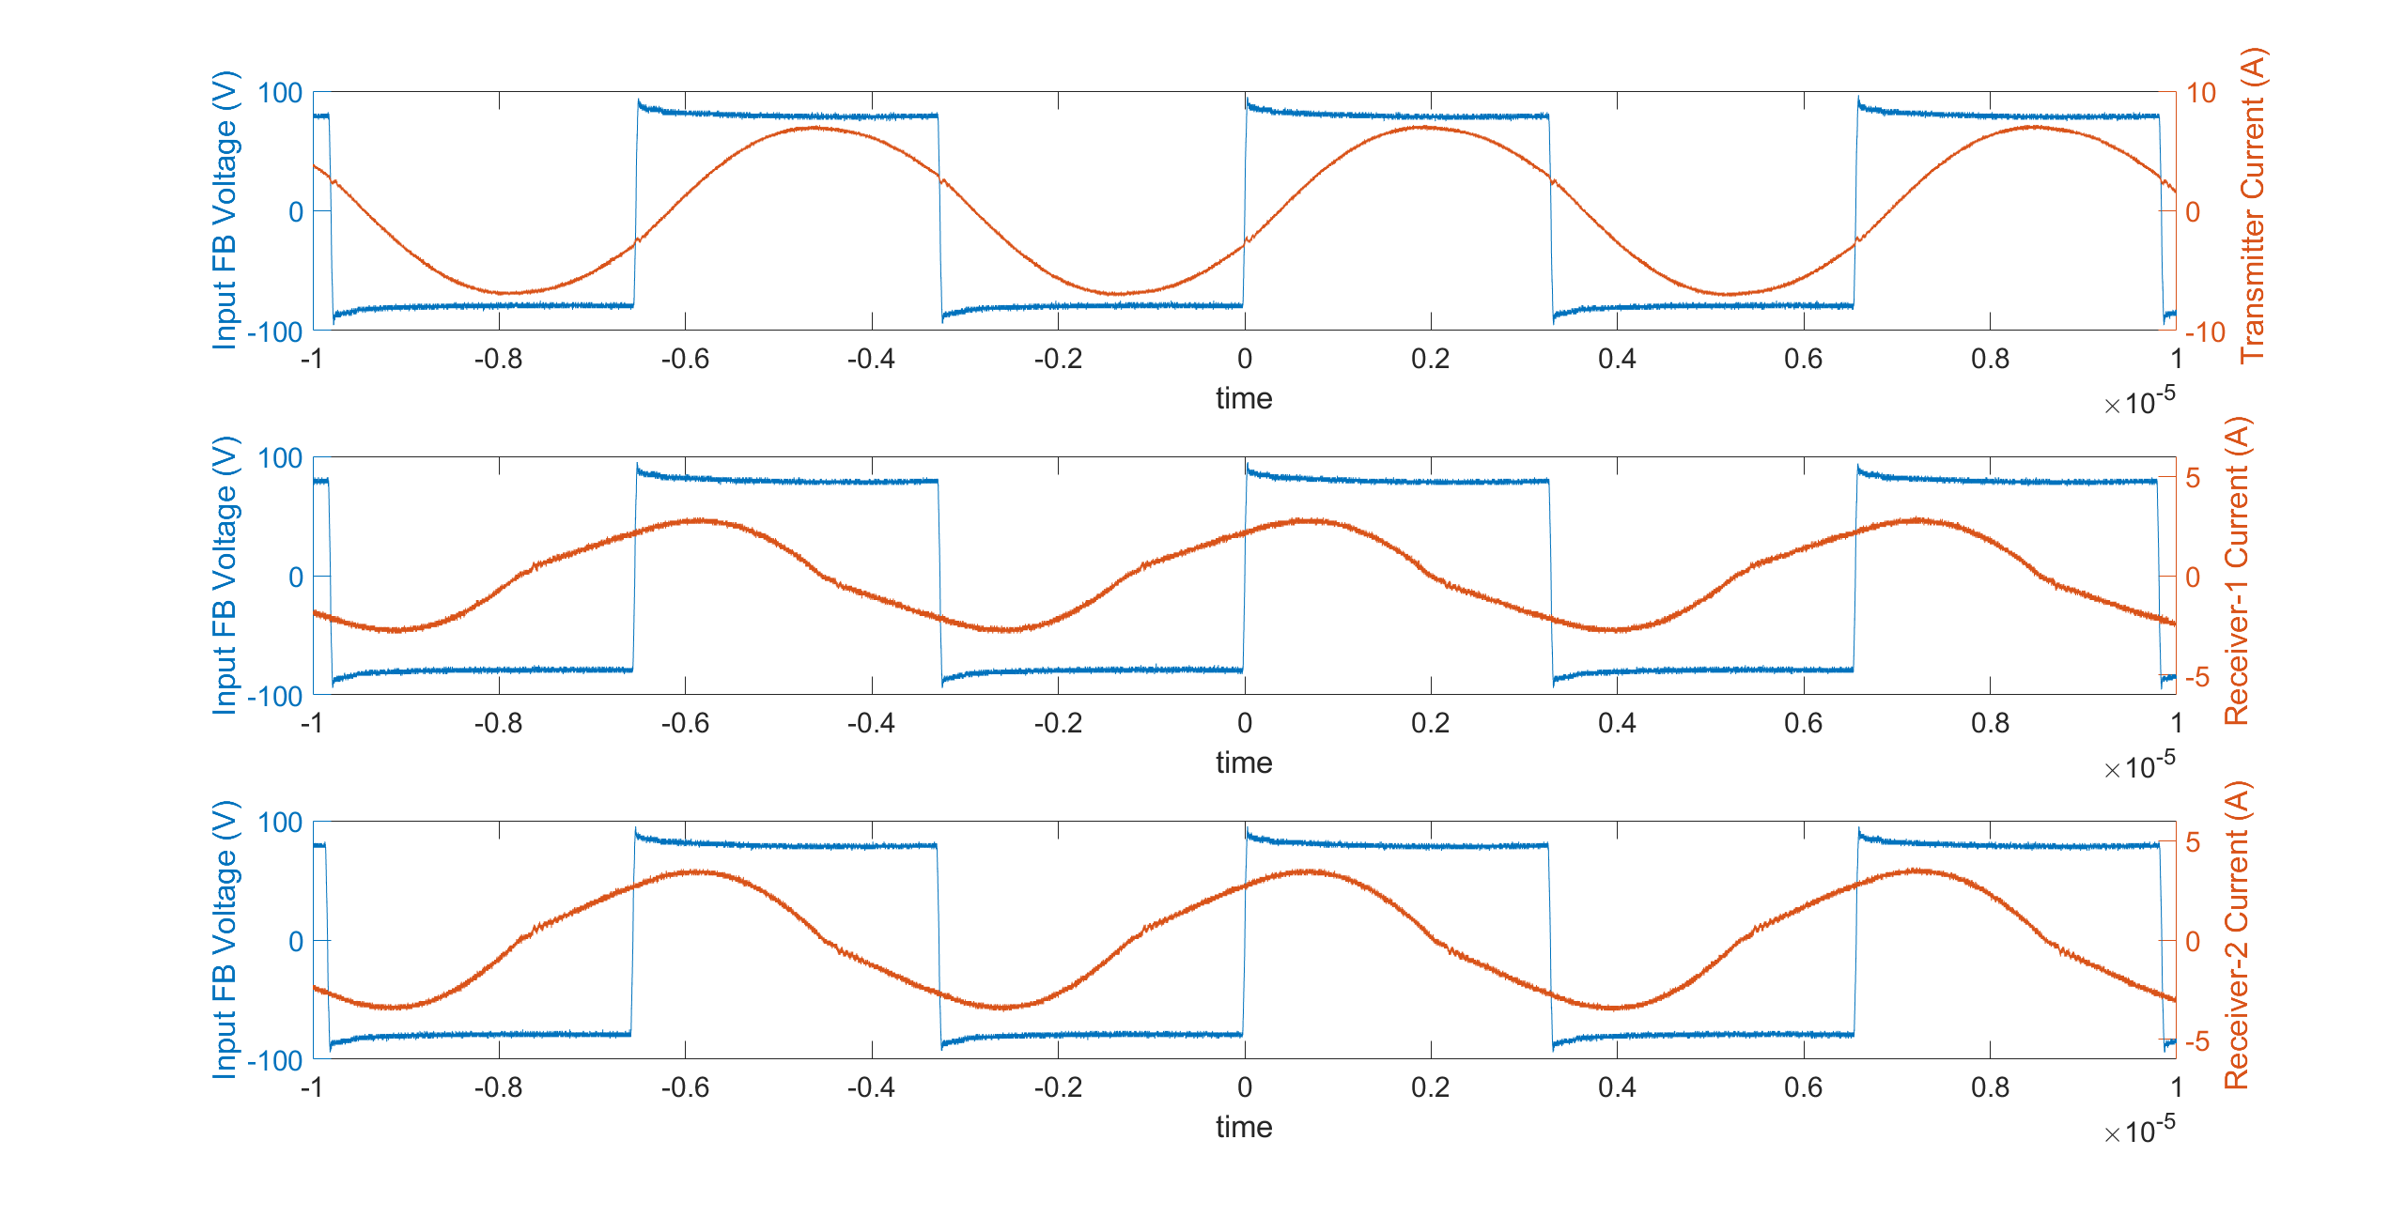
FA-Decoupled-150kHz (1)
Frequency | Ip (peak) | Is1(peak) | Is2(peak) | Ip (angle) | Is1(angle) | Is2(angle)
152kHz | 7.17A | 2.93A | 3.57A | 19.93 | 67.5 | 65.2

Slide 12
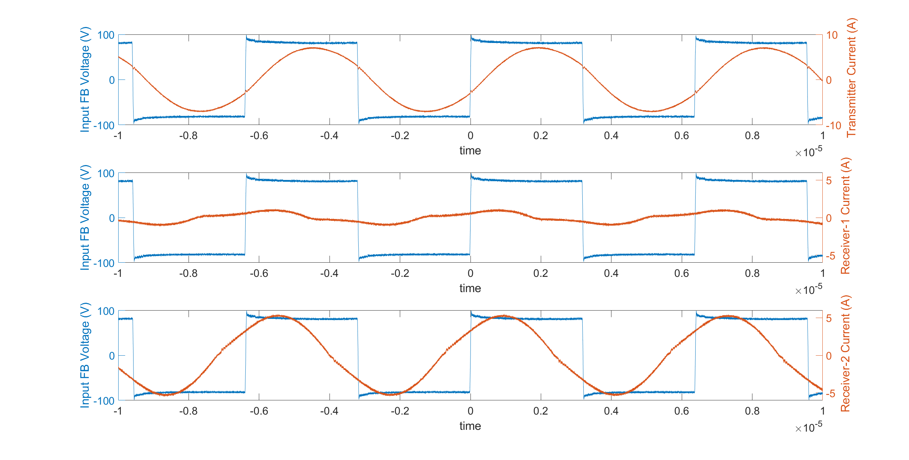
MA-Decoupled-150kHz (3)
Frequency | Ip (peak) | Is1(peak) | Is2(peak) | Ip (angle) | Is1(angle) | Is2(angle)
156.8kHz | 7.25A | 1.17A | 5.09A | 22.8711 | 74.8448 | 44.1957

Slide 13
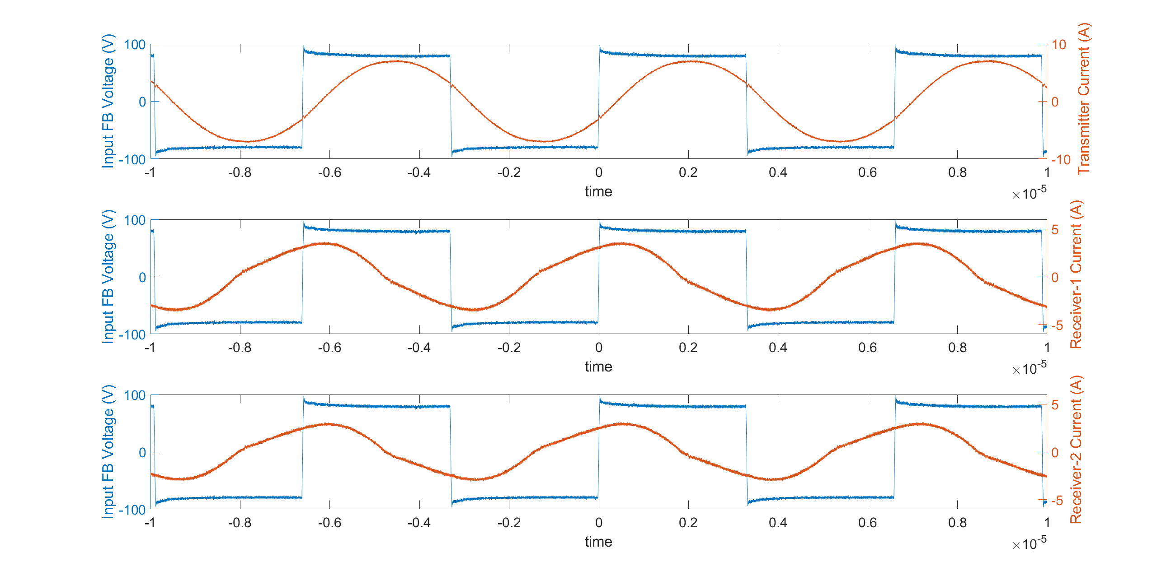
FA-Coupled-150kHz (5)
Frequency | Ip (peak) | Is1(peak) | Is2(peak) | Ip (angle) | Is1(angle) | Is2(angle)
151.6kHz | 7.17A | 3.65A | 3.09A | 22.524 | 76.68 | 74.1722

Slide 14
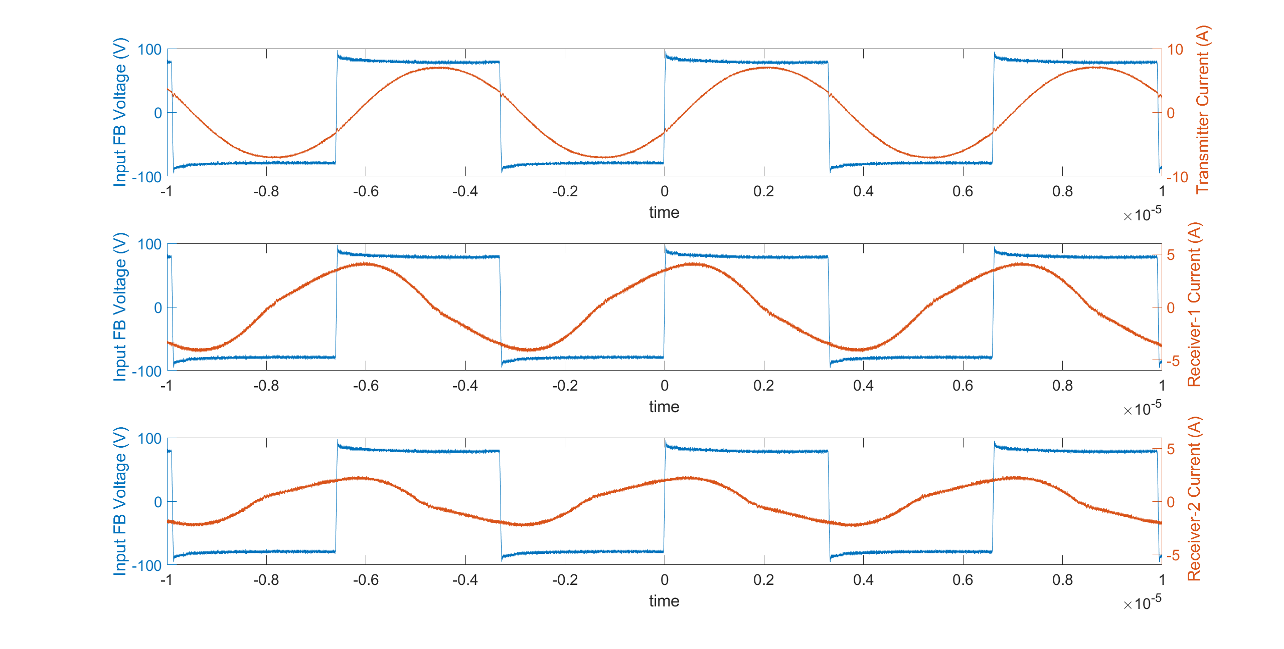
MA-Coupled-150kHz (7)
Frequency | Ip (peak) | Is1(peak) | Is2(peak) | Ip (angle) | Is1(angle) | Is2(angle)
151.3kHz | 7.17A | 4.21A | 2.37A | 22.31 | 72.18 | 82.7542

Slide 15
Primer side stay the same for coupled and decoupled systems shown at figure.

